Slide 1
Email Spam Detection using Naive Bayes
Abdul Wahid Modassar 65292
Babar 65731

Slide 2
Introduction
Email Spam Problem
Spam emails waste time and storage
Can contain scams and malicious links
Manual filtering is inefficient
Need for automated spam detection system

Slide 3
Problem Statement
Large volume of unwanted emails
Existing filters sometimes fail
Need for intelligent ML-based solution
Automatic classification of emails

Slide 4
Objectives
Build Spam/Ham classifier
Use machine learning (Naive Bayes)
Improve accuracy of email filtering
Reduce human effort

Slide 5
Dataset
Dataset name: spam.csv
Total emails: 5572
Spam emails: 747
Ham emails: 4825
Columns:
  Category
  Message

Slide 6
Methodology
Steps followed:
Data collection
Data preprocessing
Text cleaning (NLTK)
Feature extraction (TF-IDF / Bag of Words)
Model training (Naive Bayes)
Testing and evaluation

Slide 7
System Architecture
Flow:
Email ➝ Cleaning ➝ Vectorization ➝ Naive Bayes Model ➝ Spam / Ham Output

Slide 8
Tools & Technologies
Python
Google Colab
Pandas
NumPy
NLTK
Scikit-learn
Matplotlib & Seaborn

Slide 9
Experimental Results
Model Performance:
Accuracy: 97.84%
Precision: 93.96%
Recall: 92.76%
F1 Score: 93.36%

Slide 10
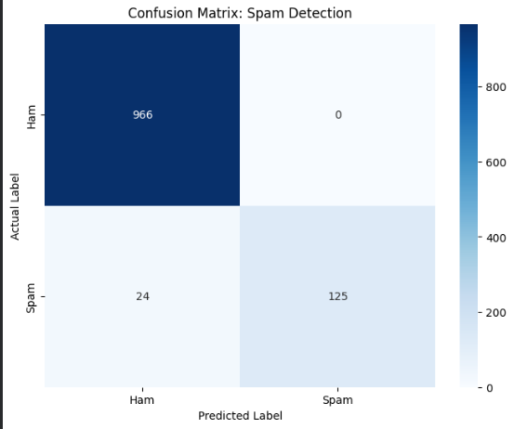
Confusion Matrix

Slide 11
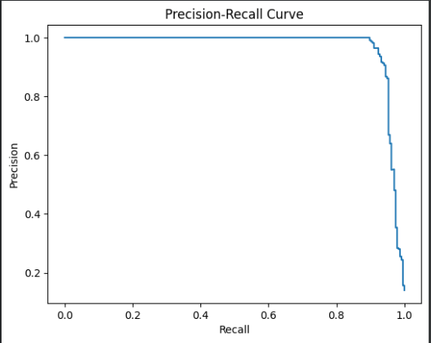
Graphs & Visualizations

Slide 12
Qualitative Analysis
Important spam keywords detected:
free
win
prize
click
offer
This shows how model understands spam patterns.

Slide 13
Advantages
High accuracy
Fast prediction
Simple and efficient model
Easy to deploy

Slide 14
Limitations
Cannot detect new unseen spam types
Needs regular retraining
Depends on quality of dataset

Slide 15
Future Scope
Deep learning models (LSTM, BERT)
Real-time email filtering
Web and mobile application
Gmail integration

Slide 16
Conclusion
The project successfully detects spam emails using Naive Bayes.
It achieves high accuracy and helps improve email security.

